Slide 1

sEQUENCE Diagrams
Brandon Davis

Slide 2
What is a sequence DIAGRAM
UML Sequence Diagrams are interaction diagrams that detail how operations are carried out. Sequence Diagrams are time focus and they show the order of the interaction visually by using the vertical axis of the diagram to represent time what messages are sent and when.
Sequence diagrams describe interactions among classes in terms of an exchange of messages over time. They're also called event diagrams. A sequence diagram is a good way to visualize and validate various runtime scenarios. These can help to predict how a system will behave and to discover responsibilities a class may need to have in the process of modeling a new system.
Source - https://www.geeksforgeeks.org/unified-modeling-language-uml-sequence-diagrams/
Source - https://www.smartdraw.com/sequence-diagram/

Slide 3
Basic Parts of sequence diagrams
Actors – An actor in a UML diagram represents a type of role where it interacts with the system and its objects.
Lifelines - A lifeline is a named element which depicts an individual participant in a sequence diagram.
Messages - Communication between objects is depicted using messages. The messages appear in a sequential order on the lifeline. We represent messages using arrows. Lifelines and messages form the core of a sequence diagram.
Guards - To model conditions we use guards in UML. They are used when we need to restrict the flow of messages on the pretext of a condition being met.
Source - https://www.geeksforgeeks.org/unified-modeling-language-uml-sequence-diagrams/

Slide 4
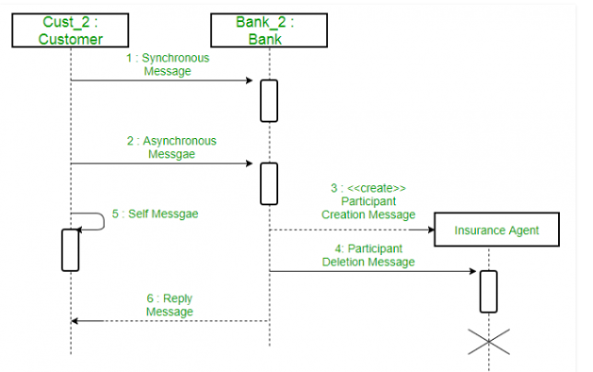
Messages
Source - https://www.geeksforgeeks.org/unified-modeling-language-uml-sequence-diagrams/

Slide 5
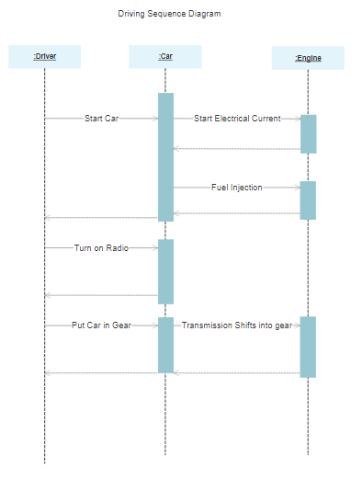
Example 1
Source - https://cloud.smartdraw.com/editor.aspx?templateId=c76624d2-8af9-4843-8aa4-76ce5e6a9f94&flags=128

Slide 6
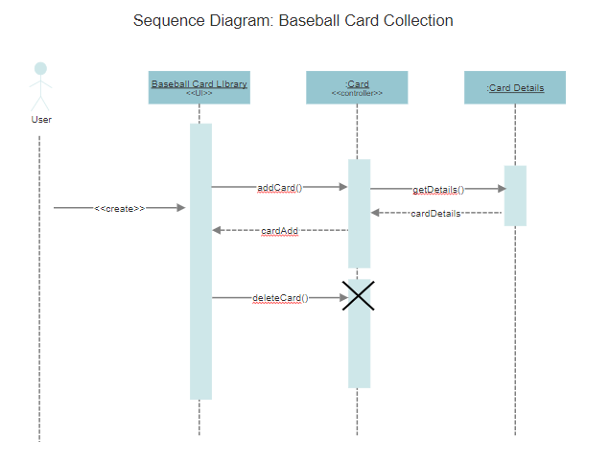
Example 2

